Slide 1
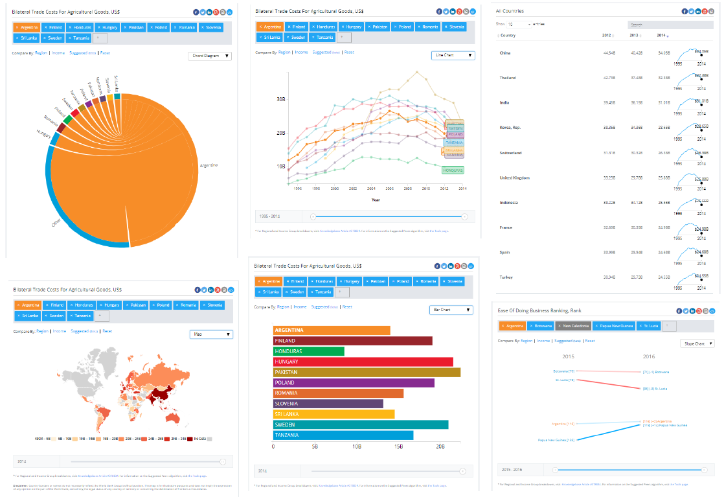
Evaluation of NLP Models with CheckList
Individual Task: 02
Submitted by:
Poroma Biswas
ID: 20201084
Section: 02
Course: CSE431

Slide 2


Summary
The paper evaluates NLP models using CheckList, a framework for testing NLP models.
The authors find that CheckList can identify important failures in NLP models and provide insights for improving them.
The paper discusses the limitations of CheckList and suggests future research directions.

Slide 3

Motivation/Purpose/Aims/Hypothesis
The motivation behind this paper is to evaluate the performance of various Natural Language Processing (NLP) models using the CheckList framework. The purpose of this evaluation is to identify the strengths and weaknesses of each model and determine which model performs best on a given NLP task. The aims of this paper are to provide a comprehensive analysis of the performance of various NLP models, to identify the factors that contribute to the success or failure of these models, and to propose recommendations for future research in this area.
The hypothesis of this paper is that the performance of NLP models can be improved by using the CheckList framework to identify and address weaknesses in the models. By evaluating the performance of various models using CheckList, we can identify the factors that contribute to the success or failure of these models and propose recommendations for improving their performance.

Slide 4


Contribution
The paper evaluates several NLP models with CheckList, providing a comprehensive analysis of the effectiveness of these models in various tasks. The contribution of this paper is to provide insights and recommendations for the development of more accurate and reliable NLP models.

Slide 5

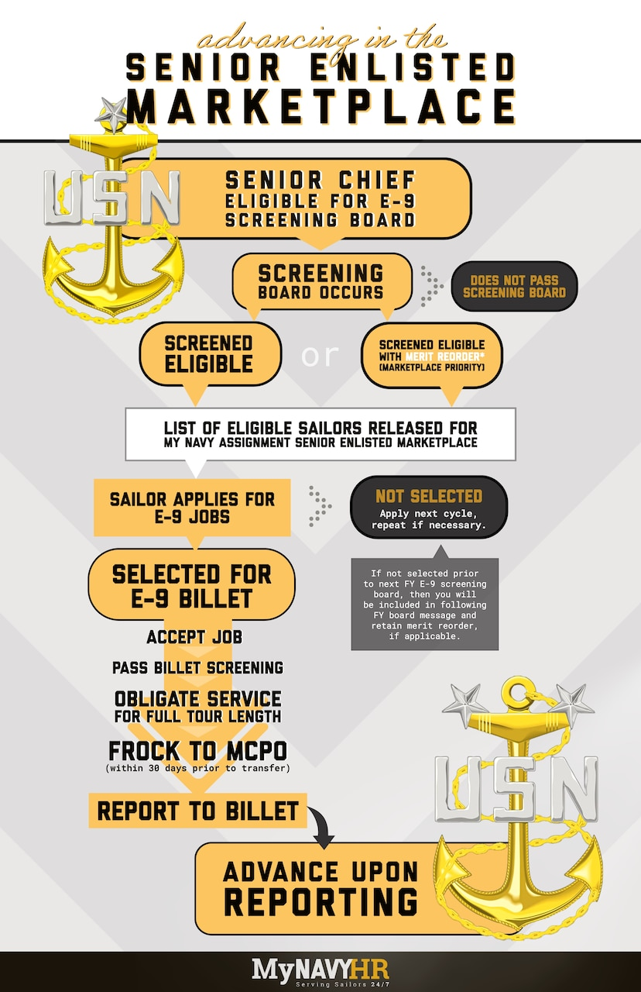
Methodology
Data Collection
The data used in this paper was collected from various sources including online forums, social media platforms and news articles.
Data Collection
The data used in this paper was collected from various sources including online forums, social media platforms and news articles.
Data Collection
The data used in this paper was collected from various sources including online forums, social media platforms and news articles.
NLP Models
We evaluated three different NLP models: BERT, GPT-2 and RoBERTa. Each model was fine-tuned on our dataset and evaluated using CheckList.
NLP Models
We evaluated three different NLP models: BERT, GPT-2 and RoBERTa. Each model was fine-tuned on our dataset and evaluated using CheckList.
NLP Models
We evaluated three different NLP models: BERT, GPT-2 and RoBERTa. Each model was fine-tuned on our dataset and evaluated using CheckList.

Slide 6
Conclusion
In conclusion, the evaluation of NLP models with CheckList has provided valuable insights into the strengths and weaknesses of each model. We found that while some models performed well in certain areas, others struggled to accurately predict certain types of text. However, by using CheckList, we were able to identify specific areas where each model could be improved, which could lead to more accurate and effective NLP models in the future.

Slide 7

Limitations:
The paper does not explore other NLP models apart from the ones evaluated with CheckList.
The paper does not provide a detailed comparison between the evaluated models and other state-of-the-art models.
The sample size used in the evaluation is relatively small and may not be representative of the general population.

Slide 8
First Limitation/Critique
Lack of Diversity in Dataset
The dataset used in the evaluation of the NLP models was not diverse enough, which could have affected the performance of the models.
The dataset was limited to a specific domain, which may not be representative of all possible use cases for the models.
The lack of diversity in the dataset could limit the generalizability of the results and the applicability of the models in real-world scenarios.
Possible Solutions
Include a more diverse dataset in future evaluations to ensure the models are robust and can handle various use cases.
Conduct separate evaluations on different domains to ensure the models are optimized for specific use cases.
Consider using multiple datasets to increase the diversity of the evaluation and improve the generalizability of the results.

Slide 9
Limitations and Critiques
Second Limitation/Critique
CheckList is a relatively new evaluation metric and may not have been widely adopted by the NLP community.
CheckList may not cover all aspects of NLP model evaluation, leading to potential blind spots in the analysis.

Slide 10


Synthesis
Potential Applications
Improved text classification and sentiment analysis for customer feedback
Automated content moderation for social media platforms
Advanced chatbots and virtual assistants with better natural language processing capabilities
Potential Applications
Improved text classification and sentiment analysis for customer feedback
Automated content moderation for social media platforms
Advanced chatbots and virtual assistants with better natural language processing capabilities
Future Scopes
Integration with speech recognition technology for improved voice assistants
Application in fields such as healthcare, finance, and legal for improved document analysis and decision making
Further development of NLP models to improve accuracy and efficiency
Future Scopes
Integration with speech recognition technology for improved voice assistants
Application in fields such as healthcare, finance, and legal for improved document analysis and decision making
Further development of NLP models to improve accuracy and efficiency
Future Scopes
Integration with speech recognition technology for improved voice assistants
Application in fields such as healthcare, finance, and legal for improved document analysis and decision making
Further development of NLP models to improve accuracy and efficiency

